Slide 1



PGP
IMPLEMENTATION OF
PGP
Enabling a Secure Communication System

Slide 2
INTRODUCTION
PGP Encryption
Definition: A method to secure emails and files through encryption. Mechanism:Symmetric and Asymmetric Encryption: Uses both methods for protection.
Encryption Process: Converts messages into a scrambled format.
Decryption: Only the intended recipient with the specific key can read the message.
Protection Prevents: Eavesdropping and data breaches.
Usage: Common in commercial settings to secure sensitive information and communications.

Slide 3
OBJECTIVE
Objective
Definition: A method to secure emails and files through encryption.Mechanism:Symmetric and Asymmetric Encryption: Uses both methods for protection.
Encryption Process: Converts messages into a scrambled format.
Decryption: Only the intended recipient with the specific key can read the message.
Protection:Prevents: Eavesdropping and data breaches.
Usage: Common in commercial settings to secure sensitive information and communications.

Slide 4
PGP
L I T E R A T U R E
S U R V E Y

Slide 5
S.no | Author | Year | Techniques / Methods | Drawbacks
01 | S. Khan, F. et. all | 2022 | Advancement in Vehicular Public key Infrastructures. ( VPKI ) | Implementation is relatively hard.
02 | Mauro Barni. et. all | 2023 | Digital WatermarkingRobust HashingSteganography and SteganalysisBiometrics | Challenges in adapting to rapid technological advancements, such as deepfakes and synthetic mediaNeed for evolving legal frameworks to manage technological advancements and prevent misuseBalancing the benefits of new technologies with privacy concerns and potential misuse
03 | Jingwei Jiang. et. all | 2024 | Quantum-Resistant Password-Authenticated Symmetric Searchable Encryption (QPASE)Lattice-Based CryptographyThreshold Oblivious Pseudorandom Function | Challenges in adapting traditional cryptographic schemes to post-quantum environments
04 | Jingwei Jiang. et. All | 2024 | Quantum-Resistant Password-Protected Secret Sharing (PPSS)Lattice-Based CryptographyQuantum-Resistant Data Outsourcing | Challenges in ensuring robustness against various quantum computing attacksPotential performance trade-offs compared to non-quantum-resistant schemes

Slide 6
S.no | Author | Year | Techniques / Methods | Drawbacks
05 | V.G. Karantaev. et. all | 2023 | Implementation of Cryptographic Measures in Digital SubstationsSecure Inter-Network Communication for IEC 61850-8-1 (MMS) Protocol | Challenges in effectively securing digital communication protocols used in highly automated substations
06 | Vincenzo De Angelis. et. all | 2022 | Digital Health (eHealth) Innovation and ChallengesIntegration of 6G Wireless Networks in Healthcare | Existing network infrastructures may not fully support the digitalization of healthcare.
07 | Cristian Bermudez Serna. et. all | 2023 | Post-Quantum Cryptography (PQC) for Shared Mutual Authentication (SMA)Implementation of Kyber Algorithm in SMA | Kyber-based SMA requires more random bytes and has a longer execution time compared to baseline mechanisms.
08 | Mi Song, Ding Wang | 2024 | Two-Factor AuthenticationAttribute-Based Password Authenticated Key Exchange (AB-PAKE)Flexible and Fine-Grained AuthorizationPrivacy Preservation and Dynamic Access Control | Although the protocol is round-optimal and reduces pairing operations, its implementation and management of storage devices could be complex.

Slide 7
Problem Finding
Our literature survey highlighted several critical issues:
1. Inadequate Encryption Implementation: Many systems lack robust encryption, leaving sensitive data exposed to unauthorized access and breaches. Proper encryption is crucial for protecting data confidentiality during transmission and storage.
2. Risk of Data Manipulation: Without effective encryption, data is vulnerable to manipulation and tampering. This can compromise the accuracy and reliability of information, impacting decision-making and operational integrity.
3. Insufficient Integrity Checks: Many systems do not employ adequate integrity verification, making it difficult to detect unauthorized changes. This vulnerability increases susceptibility to attacks such as phishing, where attackers can deceive users into compromising sensitive information.
Addressing these gaps is essential to enhancing data security and protecting against cyber threats.
PGP
90%
OF SUCCESSFUL CYBER-ATTACKS START WITH PHISHING EMAILS

Slide 8




SOLUTION
We propose using TAILS OS and TOR to route traffic, which ensures user anonymity and leaves no traces by running entirely from RAM and restarting cleanly. This solution enhances security by protecting data from manipulation and unauthorized access.
Using the PGP mechanism allows us to perform integrity checks to detect any spam or unauthorized data flows.
We use a decentralized server and PGP encryption to secure data, with OTR encryption adding an extra layer of protection for enhanced privacy.

Slide 9

ARCHITECTURE
Server → Client A (Implementation)
Detects Destination
Requests PGP Key Pair
Key Management Service (KMS)
Generates Public and Private Keys
Sends Public Key to Client A
1. Data Flow Initiation:
Server sends data to Client A.
Client A requests public/private keys using PGP.
2. Key Generation:
Key Management Service (KMS) generates keys.
Client A receives a public key.
3. Data Encryption:
Client A encrypts data with Client B’s public key.
4. Data Transmission:
Encrypted data is sent to Client B.
Data is secure, even if intercepted.
5. Data Decryption and Integrity Verification:
Client B decrypts data with its private key.
Verifies data integrity using PGP mechanisms.
PROCESS 1
Client B
Decrypts Data with Private Key
Verifies Integrity with PGP
Result: "Secure and Unmodified Data Received"
Client A
Encrypts Data with Client B's Public Key
Network (“with notation: Encrypted Data Transfer")
Potential Sniffing Attack
PROCESS 3
PROCESS 2

Slide 10
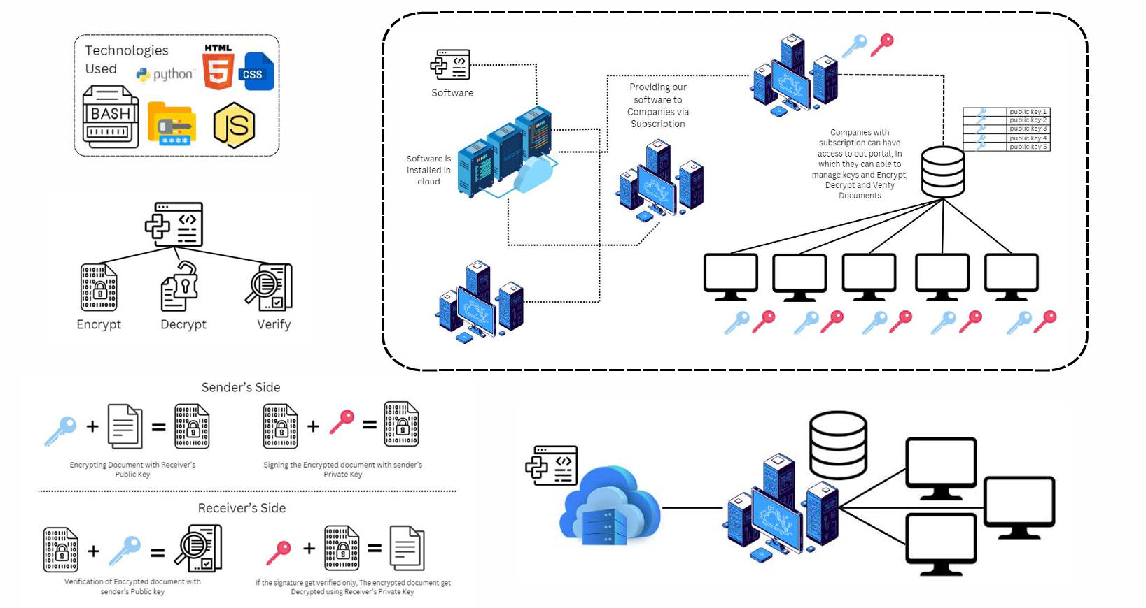

Slide 11
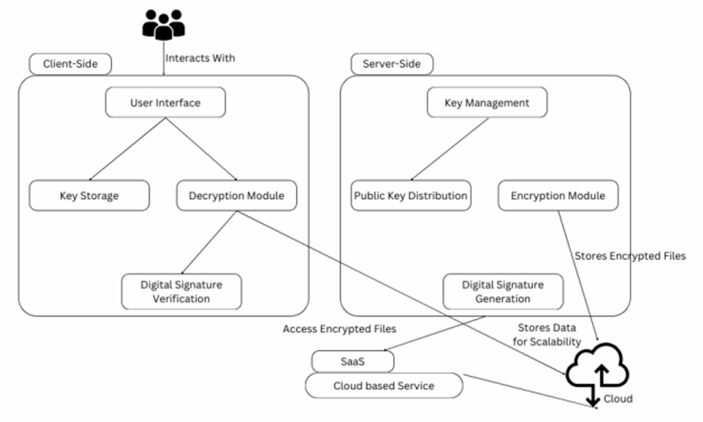
Client-Side: Users interact with modules for key storage, decryption, and digital signature verification.
Server-Side: Manages key distribution, encryption, and digital signature generation.
Cloud: Stores encrypted files for scalability and accessibility via a SaaS model.
Architecture Diagram

Slide 12

FEASIBILITY
01
Software requirement is minimalistic
02
Can implemented to any system based on requirements
03
Low cost implementation
04
Easy to maintain
05
Can be applied to old systems
06
Integrity Verification can be done
07
Secure Platfom

Slide 13





IMPACT AND BENEFITS
Objective n° 1
Objective n° 2
Objective n° 3
No complex mechanism involved. We provide a good user interface.
Can be able to create a most secured system of communication and make a stable encryption standard.
By implementing this system, we can able to potentially mitigate other cyber attacks such as MIMT and Phishing.

Slide 14
Testing
Key Management: Testing key generation, storage, and retrieval.
Encryption/Decryption Modules: Verifying correct encryption and decryption processes.
Digital Signature Generation/Verification: Ensuring signatures are correctly created and validated.
Public Key Distribution: Checking that keys are distributed securely.
Tests are written to cover various inputs, including expected and unexpected cases.
Tests run automatically, making it easier to detect bugs early during development.
Failures in unit tests indicate issues within specific units, helping developers quickly identify and fix problems.
Functionality Testing: Ensures the software performs its core functions correctly.
Performance Testing: Checks the software’s responsiveness, stability, and scalability under load.
Usability Testing: Verifies that the software is user-friendly and intuitive.
Security Testing: Identifies vulnerabilities and ensures data protection.

Slide 15
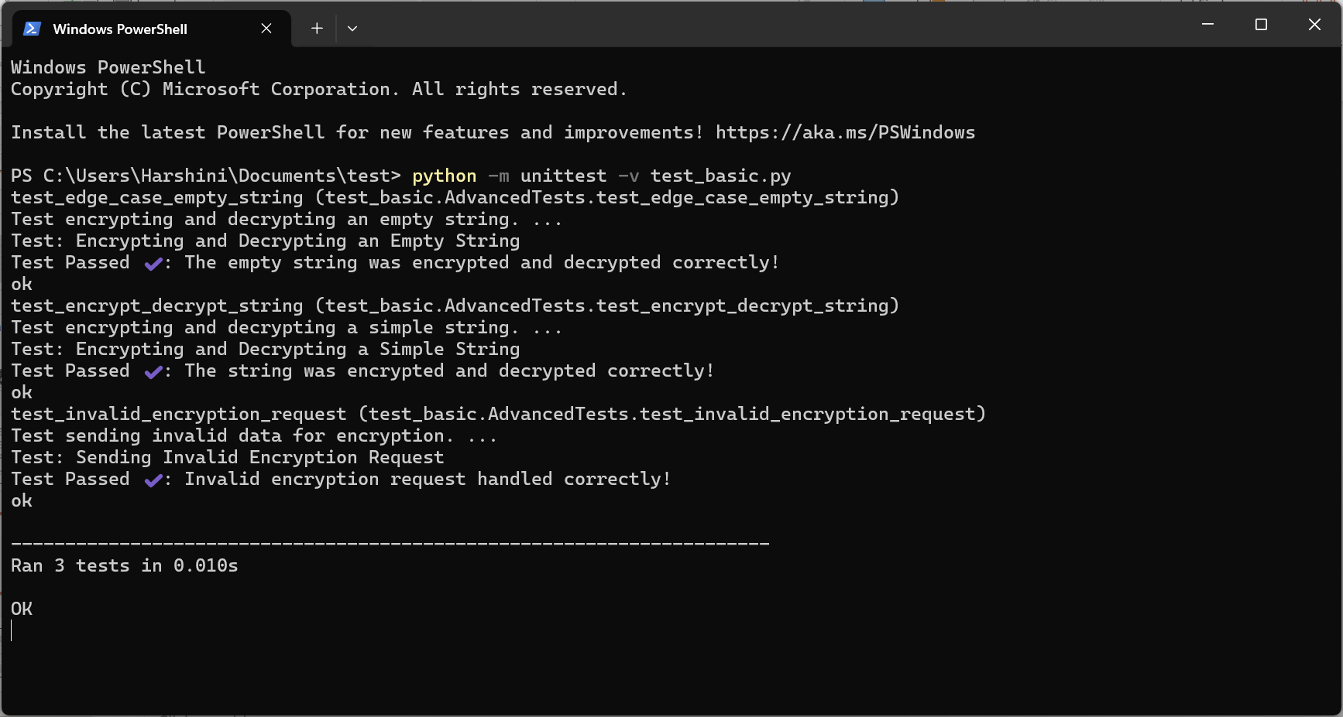

Slide 16
Sequence Diagram
Class Diagram
User: Authenticates and sends data.
Server: Receives, stores, and verifies data.
DataFlow: Handles data encryption, decryption, and integrity checks.
EncryptionService: Provides encryption and decryption methods.
TrafficRouter: Routes traffic through TOR for anonymity.
The diagram shows how these components interact to ensure secure, encrypted communication.
User initiates the process by routing traffic through the TrafficRouter.TrafficRouter sends encrypted data to the EncryptionService.EncryptionService encrypts the data and returns it to the User.User then sends the encrypted data to the Server.Server verifies the data's integrity through the EncryptionService.EncryptionService returns the integrity status to the Server.Server acknowledges receipt and integrity status to the User.
Use Case Diagram
User: Can authenticate, send data securely, and verify data integrity.
System Administrator: Monitors data integrity and oversees system operations.
System: Handles user authentication, encrypts data, routes traffic through TOR, transmits data, and verifies its integrity.

Slide 17
Activity Diagram
DFD Diagram Level 1
Start: User initiates the process.
Authenticate: User is authenticated.
Generate Keys: Keys are generated for encryption.
Encrypt Data: Data is encrypted.
Route Through TOR: Encrypted data is routed through TOR.
Transmit Data: Data is transmitted to the server.
Verify Integrity: Data integrity is checked by the server.
Store Data: Verified data is stored.
End: Process completes successfully, or data is rejected if integrity fails.
User interacts with the Authenticate User process by providing login credentials.
Authenticate User process communicates with the User Database to store and retrieve credentials.
Authenticate User sends authenticated data to the Encrypt Data process.
Encrypt Data process encrypts the data and passes it to the Route Data process.
Route Data process routes the data and sends it to the Transmit Data process.
Transmit Data process sends the data to the Verify Data Integrity process.
Verify Data Integrity process checks the data and sends it to the Store Data process.
Store Data process stores the data in the Data Store.
System Administrator monitors the Verify Data Integrity process.

Slide 18
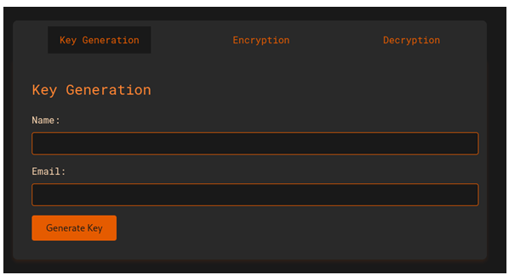
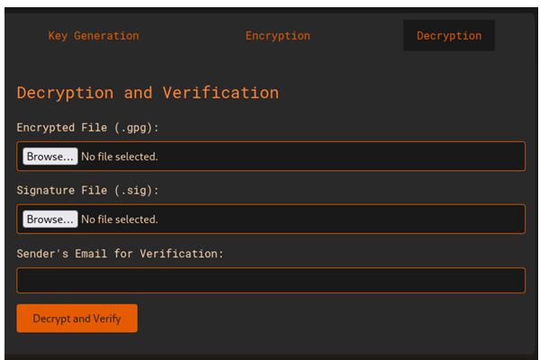
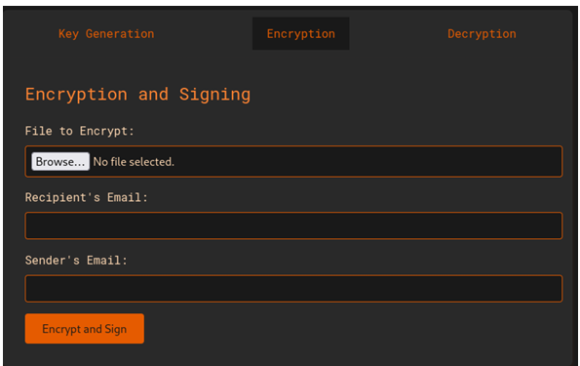
Program Output
Decryption Module
Key Generation
Encryption Module

Slide 19
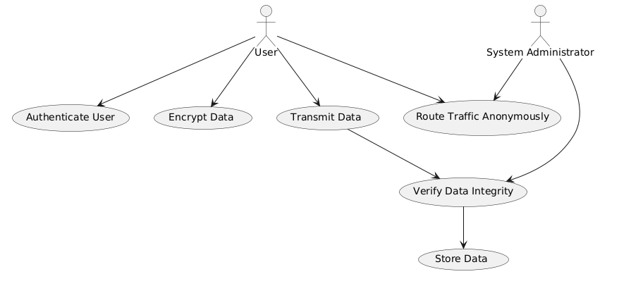
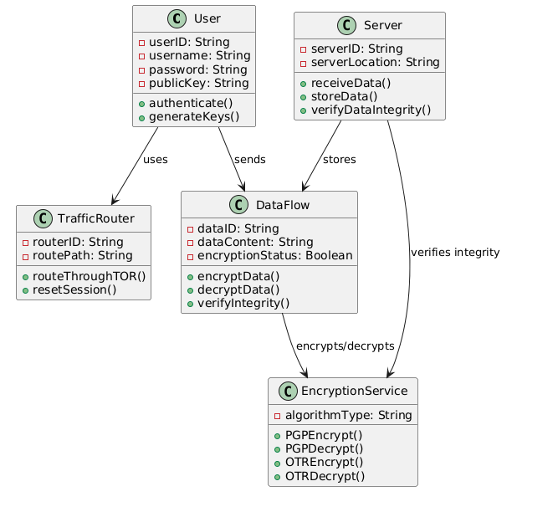
Use Case Diagram
Class Diagram
Class and Use Case Diagram

Slide 20
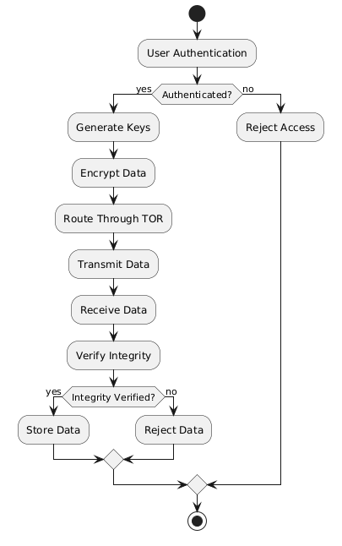
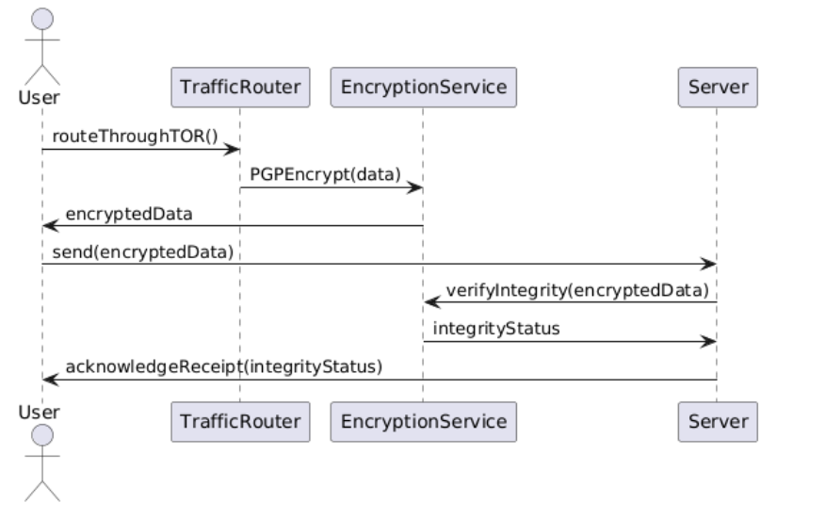
Activity Diagram
Sequence Diagram

Slide 21
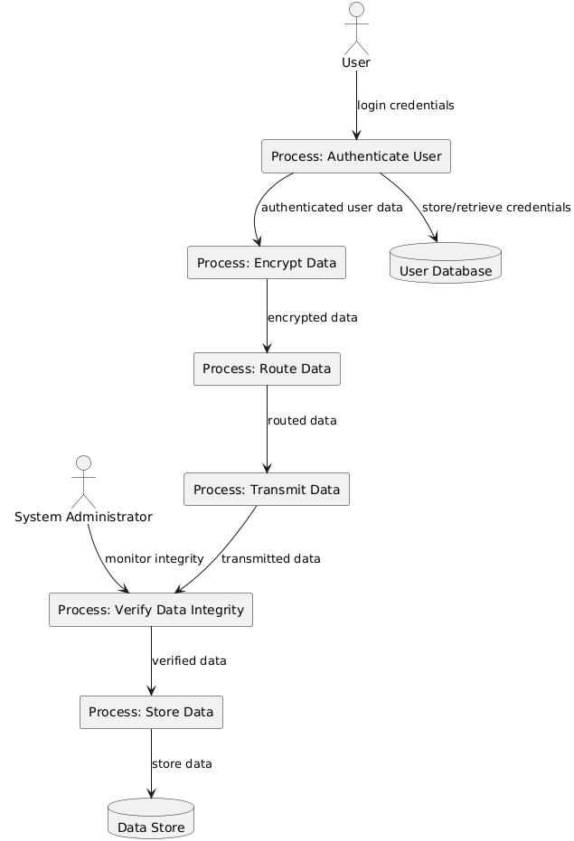
DFD Diagram Level 1

Slide 22
Conclusion
Unit testing in this Flask application ensures that core features—encryption, decryption, and error handling—function as expected. Testing isolated components allows early bug detection, confirms correct functionality, and builds confidence for code refactoring. The tests cover normal strings, empty strings, and invalid requests, verifying robustness and handling of edge cases. Overall, unit testing improves the reliability, maintainability, and stability of the application.

Slide 23
References
G. Armano, S. Marchal, and N. Asokan, "Real-time client-side phishing prevention add-on," published in 2016 IEEE 36th International Conference on Distributed Computing Systems (ICDCS), pp. 777-778. DOI: 10.1109/ICDCS.2016.44
Z. Futai, Y. Geng, B. Pei, P. Li, and L. Lin, "Web phishing detection based on graph mining," published in 2016 2nd IEEE International Conference on Computer and Communications (ICCC), pp. 205-210. DOI: 10.1109/COMPComm.2016.7924867
V. R. Hawanna, V. Y. Kulkarni, and R. A. Rane, "A novel algorithm to detect phishing URLs," published in 2016 International Conference on Automatic Control and Dynamic Optimization Techniques (ICACDOT), pp. 548-552. DOI: 10.1109/ICACDOT.2016.7877645
J. Hu, X. Zhang, Y. Ji, H. Yan, L. Ding, J. Li, and H. Meng, "Detecting phishing websites based on the study of the financial industry webserver logs," published in 2016 3rd International Conference on Information Science and Control Engineering (ICISCE),

Slide 24
OUR TEAM
Guruprasath P
Madhuvanthiy S
Harshini MD
Artificial intelligence and data Science
III Year
Artificial intelligence and data Science
III Year
Artificial intelligence and data Science
III Year

